Slide 1
COMP 379 Final Presentation
Nicholas Synovic, Emmanuel Amobi, Zac Neuhardt, Brian Nguyen, and Jake Palmer

Slide 2
Goal
We want to cluster Chicago crime reports based off of a variety of features
Our dataset is the Chicago Data Portal’s Crimes - 2001 to Present
To see any predictive features the dataset may have, as well as any correlations within the dataset

Slide 3
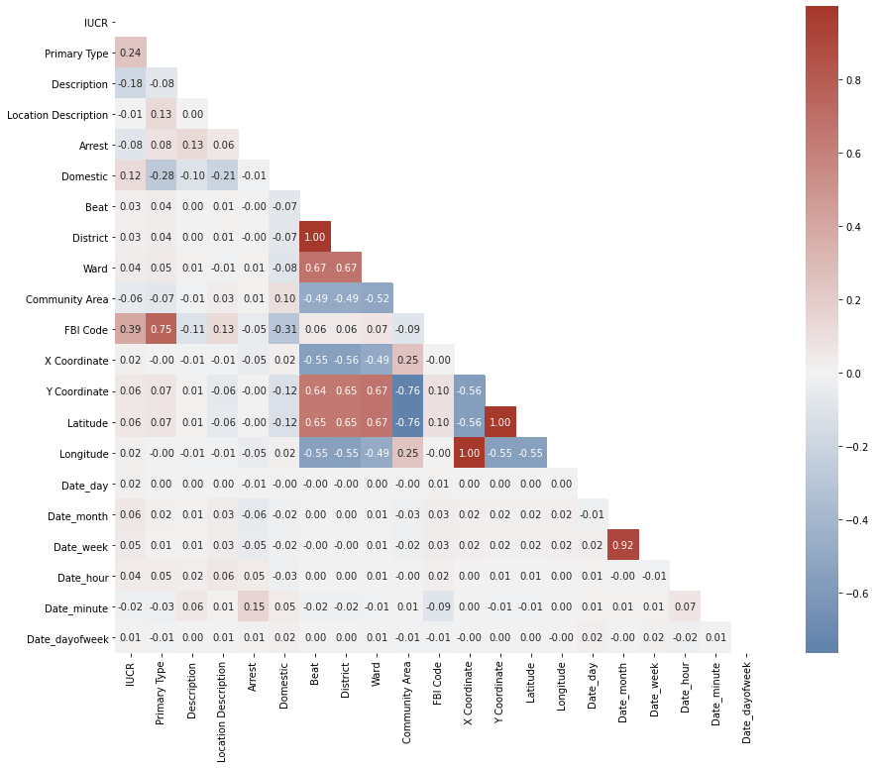
Data Preparation
Had to reduce the population size of the dataset
Raw dataset has crimes from 2001 to 2021
Over 7 million crimes with 22 features per sample
Focused on only 2021 crimes
Found & removed redundant features based off of a correlation matrix
I.e. Location + Latitude & Longitude
Removed Irrelevant features
I.e. Case number, ID, Updated On

Slide 4
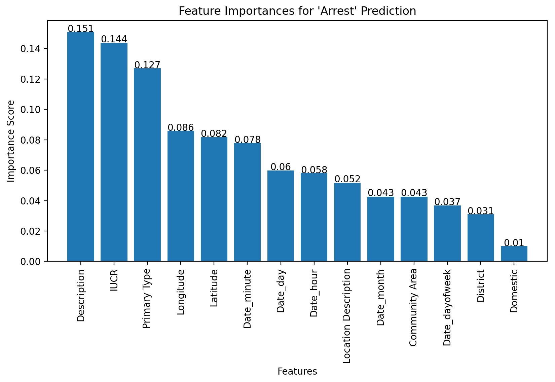
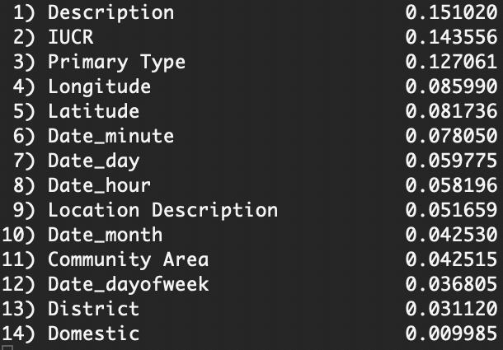
Feature Importance with Random Forest Modeling
≈ 1.0
Most Predictive
Description
IUCR
Primary Type

Slide 5
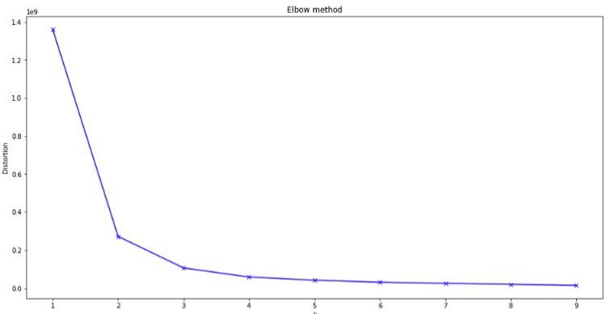
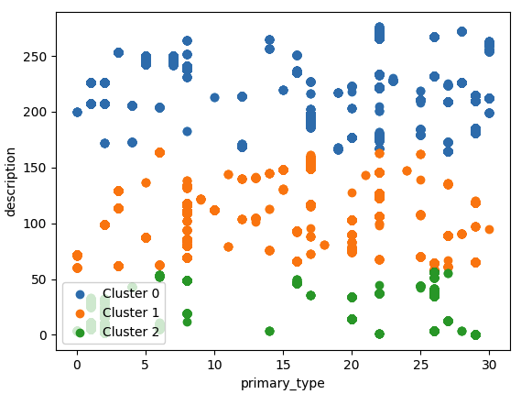
Clustering
Elbow method, distortion used to find k means
K means clustering used on every combination of 2 features (k=3)
Over 90 graphs generated
Brief mention - https://arxiv.org/ftp/cs/papers/0603/0603120.pdf

Slide 6
Conclusions
Our findings are an example of the No Free Lunch theorem
Just because we did K-Means clustering on the dataset, doesn’t mean that it was the best for the dataset
The best number of clusters to create for this dataset was 3 based off of the Elbow Method
Though our dataset could be clustered when you label encode the columns, it may not always be ideal to perform clustering on categorical(discrete) data because the outcome might not be exactly meaningful.

